Slide 1
The role of genetics in the care of Hemophiliacs
Libby H. Malphrus, MS, CGC
Certified Genetic Counselor
Children’s Hospital/ Savannah Perinatology @
Memorial University Medical Center
Clinical Genetics Instructor (Mercer University School of Medicine)
Savannah, GA
malphLi1@memorialhealth.com

Slide 2
Objectives
Review the inheritance of hemophilia A & B
Review helpful tips for explaining genetics
Discuss the importance of genetic testing
Review “My Life, Our Family” initiative
Discuss commonly held misunderstandings
Answer frequently asked questions

Slide 3
Basic Genetics
46 Chromosomes
23 pairs: 1 of each from Mom/Dad
Males: 46,XY
Female: 46,XX
Chromosomes are like “suitcases” that store our genes.
~20,000 genes in each cell
Average gene has 3,000 base pairs (A,T,G,C)
Each gene is like an “instruction booklet” for making proteins

Slide 4
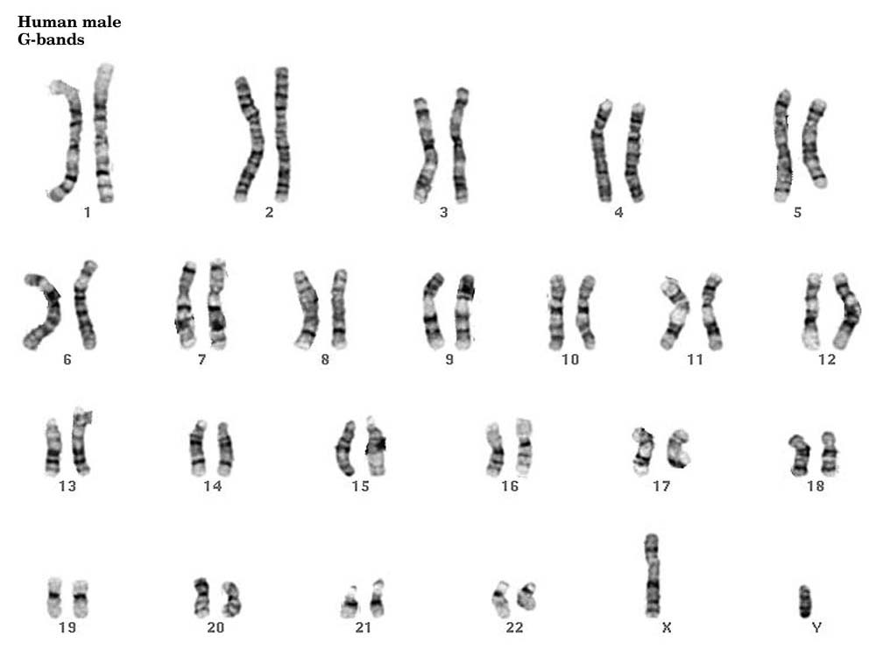

Slide 5
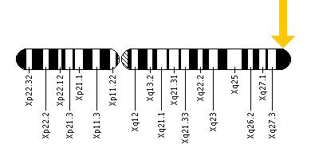
Hemophilia
X Chromosome
Hemophilia A
1:4,000-1:5,000 males
Gene: Factor VIII (8)
Location: Xq28
Hemophilia B
~1:20,000 males
Gene: Factor IX (9)
Location: Xq27
Both genes make corresponding clotting factor
Mutations cause gene not to work properly
Mutations can be inherited or de novo (new in that person)
Hemophilia A: 20-35% de novo
Hemophilia B: 50% de novo
Hemophilia B
Hemophilia A

Slide 6
X-Linked Inheritance
= Carrier
= Affected
-50% risk for non-working hemophilia gene to be passed on in every generation
-Males with mutation have hemophilia, females with mutation are carriers

Slide 7
Carrier bleeding risks
~10% of carriers have Factor levels <35%, so they are symptomatic
Sometimes mistakenly diagnosed w/ vWD
In pregnancy:
Hemophilia A: Factor 8 levels increase
Hemophilia B: Factor 9 levels do not increase
Both are at increased risk of post partum hemorrhage
Since most carriers will have normal factor levels, this is not sufficient for determining carrier status

Slide 8
Reproductive risks for men with hemophilia
ALL the daughters of affected men will be carriers
None of their sons are at risk to be affected or to be carriers

Slide 9
What are the risks for a man with hemophilia and a carrier woman?
H

Slide 10
Mrs. Smith’s son has severe hemophilia A. What is her risk to be a carrier?
Make sure to ask if there are any other affected relatives.
If her son is the only one affected, her risk to be a carrier is ~ 2/3 chance
Exception: 98% of Intron 22 inversion are inherited
What is her risk to have another affected son?
2/3 chance to be a carrier x ½ chance to pass on non-working gene x ½ chance it is a boy= 1/6 or 16-17% risk
Mrs. Smith
?
?
Hemophilia A

Slide 11
Mrs. Smith’s brother died of severe hemophilia A. What is her risk to have affected child?
Make sure to ask if there are any other affected relatives.
If her brother is the only affected, patient’s mother’s risk to be a carrier is ~2/3
If patient’s mother is a carrier, then ½ chance she passed on non-working gene to Mrs. Smith
Patient’s risk to be a carrier? 1/3
If Mrs. Smith has a son, what is his risk to be affected? 1/6
If gender is unknown, what is risk be affected? 1/12
Patient’s Mom
Mrs. Smith
?
Patient’s brother Died age 11
Severe Hemophilia B
?

Slide 12
Genetic Cause of Hemophilia
Not all mutations create the same result!

Slide 13
Hemophilia A: factor VIII (8) gene
Almost ½ of patients with severe hemophilia A have an intron 22 inversion in the F8 gene
Genetic testing is complex (>2500 mutations)
98% of mutations can be detected with a 3 tiered approach to testing
Inversion
Sequencing of entire gene
Large deletion/duplication analysis

Slide 14
Hemophilia A (F8) Gene Testing
Test Method | Mutations Detected
 |  | Severe Hemophilia A |  | Moderate or Mild Hemophilia A
 |  | Affected Males | Carrier Females | Affected Males | Carrier Females
Targeted mutation analysis | Intron 22-A inversion | 48% | 48% | 0% | 0%
 | Intron 1 inversion | 2-3% | 2-3% | 0% | 0%
Sequence analysis / mutation scanning | Sequence variants | 49% | 43% | 76%-99% | 76%-98%
Deletion / duplication analysis | Deletion / duplication of one or more exons or the whole gene | 6% | 6% | <1% | <1%
Data courtesy GeneReviews

Slide 15
Hemophilia B (Christmas Disease)
Gene: F9 (Xq27) (>1000 known mutations)
Inheritance: X-linked
(50% are de novo or not inherited)
Protein: Coagulation clotting factor IX (9)
Incidence: 1:20,000- 1 in 25,000 males
Factor IX levels:
Severe: <1%
Moderate: 1-5%
Mild: 6-30%
10% of carrier females have Factor IX levels <35%
Factor levels don’t increase in pregnancy (stable in life)
Genetic testing (sequencing) detects >99% mutations

Slide 16
Why do we need Genetic Testing?
Better understanding of severity/prognosis
Geneotype/phenotype correlation
Intron 22 inversion is always severe
Risk for inhibitors, especially in families where only 1 child is affected
20-30% develop inhibitors to Factor
Large deletions/certain mutations have higher risk than inversion 22

Slide 17
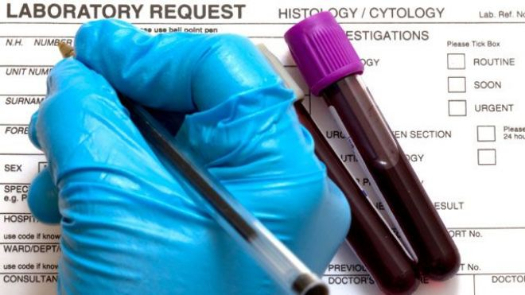
Family Planning
Accurate determination of carrier status is important
Factor levels are not sufficient for carrier testing
If family mutation is not known, carrier testing is typically not available
Families often do not know details of affected relatives
Genetic Counseling recommended prior to pregnancy to discuss risks/options
Carriers should have Factor levels checked prior to pregnancy

Slide 18
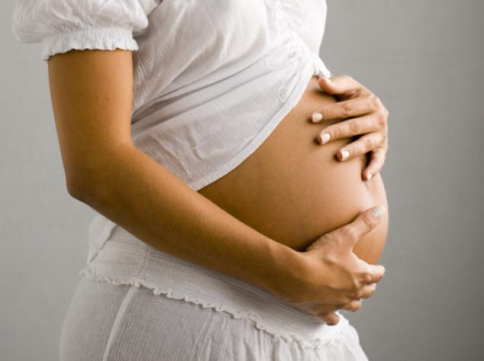
Prenatal Testing
Available at 10 weeks gestation and beyond
Chorionic Villus Sampling
0.5% risk for miscarriage
Amniocentesis
0.06% risk for miscarriage
Fetal DNA in Mother’s blood (NIPT)
Available at 10 wks+ for multiple conditions
99% detection for gender
Hemophilia testing coming soon?
Allows for decision making
Better management of pregnancy
Check factor levels in carriers in 3rd trimester
Vaginal vs. cesarean delivery
Delivery in tertiary care center w/ factor on hand
Avoidance of vacuum/forceps/scalp electrodes
Watching Mom carefully for post partum hemorrhage
Evaluation/treatment of affected newborn
1-2% risk for intracranial hemorrhage
Cord blood testing for Factor level
Delayed circumcision
Notes:
Mention common misconceptions about prenatal testing (high risk loss, etc). Discuss referrals for “testing” of fetus/newborn. Need for tertiary care center delivery b/c if tx needed after birth (brain bleed needs immediate attention). Dx helpful b/c if unaffected, don’t need all the precautions or delivery in tertiary center (helpful for patients who live far away and don’t want to drive to Savannah)

Slide 19
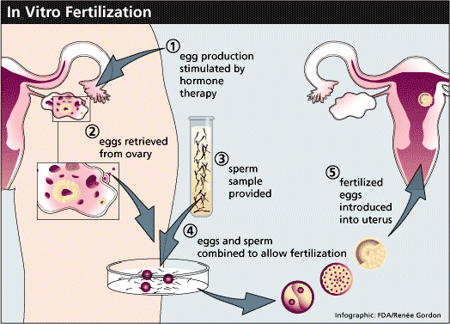
Preimplantation Genetic Diagnosis (PGD)
Requires IVF and intra-cytoplasmic sperm injection (ICSI)
Embryos are tested
Hemophilia
Common chromosome conditions
Unaffected embryos implanted
Total cost: ~$20,000-$25,000 per cycle
May take multiple cycles for successful pregnancy
Available across the US
1% of all births in 2012 were conceived through IVF
Care of child with hemophilia is far greater $
Note: Sperm sorting no longer available (not reliable)

Slide 20
Genetic Testing Process: Genotyping
Blood sent to one of a few DNA labs in the US
Often a tiered approach to testing
Inversion ($250-$350)
Sequencing (~$1500)
Deletion/Duplications (~$450)
Expensive: $350-$2,200
Results in ~2-4 weeks
If mutation is known in the family, then testing of other relatives is easy and inexpensive (~$250-350)
Insurance often doesn’t cover the cost
End result: Most have not had genotyping
ATHN Study (October 2012): Only ~20% of hemophiliacs have had genotyping
Study of >1000 hemophilia community members showed 75% of families would do genetic testing if free/low cost

Slide 21
My Life, Our Future
Collaboration between 4 organizations to provide genotyping and data storage for patients with hemophilia A & B
Available free of charge to symptomatic/affected individuals through HTC
Carrier testing hopefully available in 2015
De-identified data available for researchers

Slide 22
educational resources for your patients are available
Educational materials inform patients about My Life, Our Future program
What is genotyping?
Availability
Process for participation
Information about founding partners
Spanish materials available

Slide 23
Common misconceptions
Cause of bleeding disorder
Mom/Dad did or ate something wrong
Pregnancy/birth trauma, etc.
Often guilt/anxiety over cause
Obligate carrier status
Birth order (“myth” of the 1st born)
If female asymptomatic, then not a carrier
Prenatal testing is only for people who would end a pregnancy
All bleeding disorders are the same
Genetic conditions “skip” a generation
Inheritance tied to whether child looks/acts like that side of the family
Hemophiliacs die young and can’t have a “normal” life

Slide 24
Genetic Counseling
Master’s level trained health professionals with expertise in genetics and counseling
Non-directive approach
HemAware Magazine (February 2014) discusses the importance of genetic counseling
Only 27 / 135 HTCs have a GC on staff
NHF working to increase # GCs at HTCs
Help interpret results
Educate patients/healthcare providers
Provide resources/support
Discuss all the issues presented today

Slide 25
References/Resources
Genereviews: Great online resource for genetics
Hemophilia A: http://www.ncbi.nlm.nih.gov/books/NBK1404/
Hemophilia B: http://www.ncbi.nlm.nih.gov/books/NBK1495/
National Society of Genetic Counselors: www.nsgc.org
Find genetic counselors by city/state/zip code

